Slide 1
AUSTRALIAN INFORMATICS
THE SELECTION JOURNEY
AIO → School of Excellence
→ AIIO and FARIO
→ Selection School → IOI
Notes:
This session introduces how Australia picks its four-student IOI team. The goal: every student knows which stage comes next for them, when it happens, and what they need to learn for it. Dates and numbers are for the 2026 cycle and change a little each year.

Slide 2
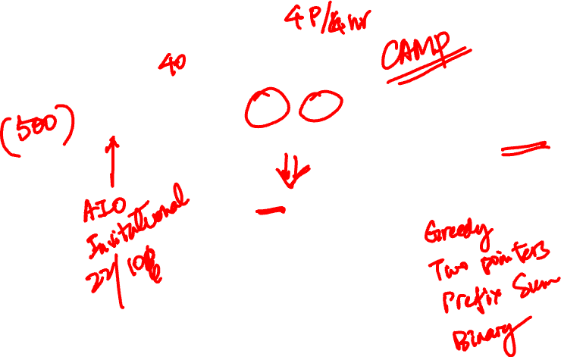
FOUR STAGES TO THE IOI TEAM
THE ROUTE
AUGUST
DECEMBER
FEB – MAR
LATE APRIL
MID-YEAR
AIO
→
School of Excellence
→
AIIO and FARIO
→
Selection School
→
IOI team
Open to any school student
Top AIO results, Year 11 or below
About 40 invited to the AIIO
19 invited in 2026
4 students
↓ FROM AIIO
EGOI team
4 girls
Every arrow is an invitation, earned by your results at the stage before.
Notes:
Walk left to right. Only the AIO is open: anyone can enter through their school. Every later stage is invitation only. The EGOI is the European Girls' Olympiad in Informatics; its four-person team is picked from AIIO results. The four colours used here stay fixed for the rest of the deck: teal = AIO, orange = School of Excellence, coral = AIIO and FARIO, navy = Selection School.

Slide 3
THE YEAR AT A GLANCE
ONE CYCLE · AUGUST TO AUGUST
When | Stage | Format | Who takes part
Aug (27 Aug 2026) | AIO | Online contest · 6 problems · 3 h | Any school student
December | School of Excellence | About 10 days, live-in training | Top AIO results, Year 11 or below
Feb (12 Feb 2026) | AIIO | 4 problems · 4 h · C++ | About 40, Australia and NZ
Mar (6 Mar 2026) | FARIO | Same format as the AIIO | IOI candidates
Apr (23 Apr – 1 May 2026) | Selection School | Live-in school + selection exams | 19 students in 2026
Aug (Tashkent, 2026) | IOI | 2 days · 3 tasks a day · 5 h a day | Team of 4
Dates are from the 2026 cycle. They move a little each year.
Notes:
One full cycle runs from one August to the next. The highlighted row is the hard gate, covered on the next slide. Sources: AMT pages for the AIO and the Selection School; the AIOC contest schedule for the AIIO and FARIO dates.

Slide 4
THE ONE RULE TO REMEMBER
YEAR 11 IS THE CUT-OFF
The December School of Excellence only invites students in Year 11 or below, and only its invitees can go on to the IOI team.
The 2026 Selection School had students from Year 8 to Year 12. Start early and you get more than one try.
Notes:
This is the single most important fact for planning. A student who first does well in the AIO in Year 12 is too late for this cycle. A Year 11 student who reaches the December school can still sit the AIIO and attend the Selection School in Year 12.

Slide 5
AIO
STAGE 1 OF 4 · OPEN TO ALL
The Australian Informatics Olympiad: the only stage anyone can enter.
Competition · online
Late August
Open entry · through your school
Notes:
The AIO is the one stage everyone in this room can do. Its score decides who is invited to the December School of Excellence. AMT does not publish the cut-off score.

Slide 6
FORMAT AND SKILLS
STAGE 1 · AIO
The contest
What you need
27 August 2026, sat online at school
6 problems in 3 hours, each worth 100 points in subtasks
C, C++, Java or Python
One paper; Intermediate (to Year 10) and Senior divisions for awards
Gold: top 10% · Silver: next 15% · Bronze: next 25%
P1–3: simulation, enumeration, careful case handling
P4–6: sorting, greedy, binary search (on the answer), prefix sums, two pointers
Sometimes: BFS, simple DP, sparse tables, parity
Brute force first: it wins the small subtasks
Read the limits: is O(N²) fast enough, or do you need O(N log N)?
Our four P6 lessons cover the P4–6 list.
Notes:
There is no official AIO syllabus. The P1–6 topic list comes from past papers, 2019 to 2026. Entry costs AUD 25.90 per student in 2026 and the entry deadline was a week before the contest.

Slide 7
SCHOOL OF EXCELLENCE
STAGE 2 OF 4 · BY INVITATION
About ten days in December where students first meet university-level algorithms.
Training school · live-in
December
Year 11 or below
Notes:
This is a school, not a contest: lectures, labs and practice contests. Only students invited here can later make the IOI team.

Slide 8
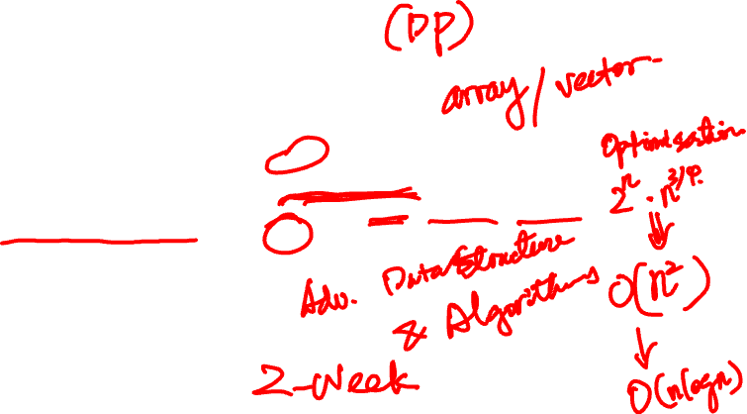
FORMAT AND WHAT YOU WILL LEARN
STAGE 2 · SCHOOL OF EXCELLENCE
The school
Topics to expect
December, about ten days; ANU, Canberra in 2025
Invited on AIO results, Year 11 or below
Lectures, labs and practice contests
No public syllabus: "second- or third-year university" level
The AIIO says most of its points need only the school's Alpha stream
Graphs: BFS, DFS, Dijkstra, spanning trees, union-find
Dynamic programming: the standard patterns
Data structures: heaps, Fenwick trees, segment trees
Trees: lowest common ancestor, binary lifting
Topic list worked out from what the AIIO and IOI expect. AMT does not publish the course outline.
Notes:
The aim of the school is to take a student from "can solve AIO Problem 6" to "can attempt invitational problems" in time for the February AIIO, about eight weeks later. C++ becomes the practical choice from here on: the AIIO and the IOI accept only C++.

Slide 9
AIIO AND FARIO
STAGE 3 OF 4 · BY INVITATION
Two contests in February and March that decide who goes to the Selection School.
Competition · × 2
Feb – Mar
C++ only
Notes:
AIIO = Australian Invitational Informatics Olympiad. FARIO = French-Australian Regional Informatics Olympiad. Invitation to the AIIO is based on AIO performance; a student's relative AIIO score is a main criterion for the next step.

Slide 10

AIIO AND FARIO SIDE BY SIDE
STAGE 3 · TWO CONTESTS
 | AIIO | FARIO
Date | 12 February 2026 | 6 March 2026
Who | About 40 invited, Australia and New Zealand | IOI candidates from France, Australia, NZ and Belgium
Format | 4 problems · 4 hours · C++ · supervised at school; printed notes and cppreference allowed, no AI | Same format and rules for Australian students
Picks | With FARIO: Selection School invitees. Also: the EGOI team of 4 | With AIIO: Selection School invitees
Syllabus | Mostly what the School of Excellence "Alpha stream" teaches | None; the IOI Syllabus is suggested as a guide
Notes:
Both are sat at school under supervision. Problems come in roughly increasing difficulty. Input and output are standard input and output, with no code templates. Students may not bring in saved code, so they need to be able to write their own brute force for testing.

Slide 11
TOPICS IN RECENT PAPERS
STAGE 3 · AIIO PAPERS 2023–2025
Topic | Example problems
Prefix sums, counting arrays, prefix max and min | 2025 P1 Buildings · 2023 P1 Sculpture III
Monotonic stack, sparse table | 2023 P3 Pinnacle
BFS, multi-source BFS, BFS from every node | 2023 P2 Electrical Fault · 2025 P3 Amazing Game II
Dijkstra with a heap | 2023 P2 Electrical Fault · 2024 P2 Overcycle
Segment tree: point update, range max and min | 2024 P1 Speed Friending
Dynamic programming, 0/1 knapsack | 2023 P1 Sculpture III · 2025 P2 Retail Empire
Permutation cycles and constructions | 2024 P3 Curator Catastrophe
Interactive task with a query budget | 2025 P4 Kth Number
Highlighted rows use techniques from our four lessons.
Notes:
All of these problems have solutions in our AIIO folder. The early subtasks of most problems need only AIO-level techniques; the full solutions need the graph, DP and data-structure material from the School of Excellence.

Slide 12
WHAT THE AIIO REWARDS
STAGE 3 · BEYOND THE TOPICS
The key observation
Partial scores
Reduce the problem until a standard technique fits
Amazing Game II gives 30% just for deciding whether the answer is zero
Constructions
Speed
Curator Catastrophe gives 50% for the count; full marks need the swaps
Most limits are N, Q ≤ 200 000: aim for about O(N log N)
64-bit integers
Your own testing
Pinnacle and Overcycle both warn that answers overflow int
No saved code allowed in: write a brute force and compare
Notes:
These six habits matter as much as the topics. Ask students which ones they already do in the AIO. Kth Number (2025 P4) adds one more: an interactive task where full marks need at most ⌈N/2⌉+1 queries, and the grader may adapt its answers.

Slide 13
SELECTION SCHOOL
STAGE 4 OF 4 · BY INVITATION
Nine days in April. At the end, the four-student IOI team is announced.
Training school · with exams
Late April
19 invited · in 2026
Notes:
The 2026 Informatics Selection School ran from 23 April to 1 May at UNSW, Sydney. Invitations are based on AIIO and FARIO results.

Slide 14

FORMAT AND SKILLS
STAGE 4 · SELECTION SCHOOL
The school
What you need
23 April – 1 May 2026, UNSW Sydney
19 students in Years 8–12, invited on AIIO and FARIO results
Training plus IOI-style selection exams
Team of 4 announced at the end; the weighting is not published
Everything from the School of Excellence and the AIIO, coded quickly and without bugs
Solving new problems by combining algorithms you already know: few new topics are taught here
Three new task types: write a function the grader calls; trade questions and answers with the grader (interactive); hand in answer files instead of code (output-only)
Managing a long exam: read every problem first, collect the easy subtask points, move on when stuck
Doing well in every exam of the week, not just one
Notes:
At this level few new topics are taught; the school is about applying known material creatively to IOI-difficulty problems. IOI tasks usually ask students to write a function that a grader calls, instead of reading standard input.

Slide 15
IOI
THE FINAL STAGE
The International Olympiad in Informatics. In 2026 it was held in Tashkent, Uzbekistan, in August.
Competition · international
2 contest days
Team of 4
Notes:
Every country sends up to four secondary-school students. The IOI is held mid-year, usually between July and September.

Slide 16
THE CONTEST AND THE SYLLABUS
THE IOI
The contest
In the syllabus
2 contest days, 3 tasks a day, 5 hours a day
C++ only
Up to 4 secondary-school students per country
Topics set by the official IOI Syllabus (2025 edition is the latest)
Graphs: BFS, DFS, shortest paths, spanning trees, matching, flow
Dynamic programming
Heaps, union-find, segment and Fenwick trees
Geometry: convex hull, sweep line
Left out: KMP and suffix arrays, hash tables, FFT, modular inverses, Nim and Sprague-Grundy theory.
Notes:
The syllabus marks each topic as included, outside of focus or excluded. The "left out" topics are explicitly excluded: knowing them gives no advantage at the IOI. The full summary is in the selection pathway document.

Slide 17
YOUR TOOLKIT AND WHAT COMES NEXT
WHERE WE ARE
Already in your toolkit
Next, for the AIIO
Prefix sum
Binary search
Two pointers
Greedy
Sparse table
BFS and graphs
Dijkstra with a heap
Dynamic programming
Segment trees
Enough for AIO Problems 4–6
Every one appears in the 2023–2025 AIIO papers
Notes:
The left card is what Lessons 1 to 4 covered. The right card is the gap between AIO Problem 6 and the AIIO. Ask: which of the right-hand topics has anyone already seen?

Slide 18
THREE THINGS TO REMEMBER
RECAP
1. Only the AIO is open.
Every later stage is by invitation, earned at the stage before.
2. Year 11 is the cut-off.
Reach the December School of Excellence by Year 11 at the latest.
3. Each stage builds on the last.
AIO: the four techniques. AIIO: graphs, DP, data structures. IOI: all of it, used in new ways.
Notes:
Ask each student to say which stage they are aiming for this year.

Slide 19
HOW THE SYLLABUS LABELS TOPICS
ADDENDUM · IOI SYLLABUS 2025 · 1 OF 3
Marker | Level | Meaning
✓ | Included, unlimited | Basic knowledge; can appear in a task without explanation
✓q | Included, to be defined | Can appear, but the task statement must define it
✓p | Included, not for task description | Needed to solve tasks, but not named in statements
? | Outside of focus | Not expected; a task may use it only if it can be solved without prior knowledge
✗? | Excluded, open to discussion | Excluded for now, under review
✗ | Explicitly excluded | Will not be needed; knowing it gives no advantage
The IOI Syllabus (2025 edition, the latest published) focuses on graphs, dynamic programming and data structures. It rules out string-matching algorithms, hash tables, FFT and most advanced mathematics.
Notes:
Source: IOI Syllabus 2025, ioinformatics.org/files/ioi-syllabus-2025.pdf. The syllabus is updated each year by the International Scientific Committee; check the latest edition before relying on a detail.

Slide 20
MATHS, PROGRAMMING AND STRATEGIES
ADDENDUM · IOI SYLLABUS 2025 · 2 OF 3
Area | Included (✓, ✓q, ✓p) | Outside of focus (?) | Excluded (✗)
Arithmetic and geometry | Integers, parity, divisibility; modular addition, subtraction, multiplication; fractions; points, vectors, polygons in the plane; primes; Euclidean distance; Pythagoras | — | 3D geometry; floating-point precision work; modular division and inverses; complex numbers; conics; trigonometry
Discrete maths | Functions, relations, sets; basic logic; proofs including induction; counting (permutations, combinations, binomial coefficients, inclusion-exclusion, pigeonhole); graph and tree vocabulary; centroids; planar graphs | Discrete probability (finite cases) | Solving recurrences; Burnside lemma; hypergraphs; treewidth; linear algebra and FFT; calculus; statistics
Programming | Language basics, arrays, strings, recursion, divide and conquer, backtracking, linked structures, pointers, simple floating point; interactive tasks | Memory representation; heap allocation; exact fractions | Non-trivial floating-point calculations
Analysis and strategies | Big O; amortized analysis; brute force; greedy; divide and conquer; branch and bound; dynamic programming | Heuristics; randomized and approximation algorithms | Average-case analysis; recurrence-based analysis; clustering; numerical optimization
Notes:
Most of the excluded maths (modular inverses, trigonometry, FFT) is common in other contests such as Codeforces, but will not be needed at the IOI.

Slide 21
ALGORITHMS AND DATA STRUCTURES
ADDENDUM · IOI SYLLABUS 2025 · 3 OF 3
Area | Included (✓, ✓q, ✓p) | Outside of focus (?) | Excluded (✗)
Algorithms | Binary search; quickselect; O(n log n) sorting; simple string algorithms; big integers; DFS and BFS; connected components; transitive closure; shortest paths; minimum spanning trees; bipartite matching; maximum flow; biconnectivity; strongly connected components; basic game analysis | — | Faster matching and flow implementations; general-graph matching; min-cost flow; matroids; alpha-beta pruning; Nim and Sprague-Grundy theory
Data structures | Stacks, queues; binary heaps; union-find; balanced, statically balanced and augmented binary search trees (covers segment trees and Fenwick trees); LCA in O(log n); tree decomposition; persistent structures; tries | — | KMP, Rabin-Karp, suffix arrays and trees, Aho-Corasick; hash tables; complex heap variants; 2D tree structures; structures for changing trees
Geometry | Points, vectors, lines; collinearity and clockwise turns; line intersection; polygon area; point in polygon; coordinate compression; convex hull; sweep line | — | Point-line duality; Voronoi and Delaunay; circle intersections; 3D linear programming
Other | Software engineering basics: APIs, testing, debugging, using an IDE | Distributed, parallel and cryptographic algorithms; automata and regular expressions | Computability; NP-hardness proofs
Notes:
The syllabus does not name segment trees or Fenwick trees directly; earlier editions listed them under statically balanced and augmented binary search trees.

